Slide 1
Hotel Management System
Final Documentation Presentation

Slide 2
Authors
Racheal Kavuu Mailu (SCT121-0713/2023)
Stephen Kamau (SCT121-0714/2023)

Slide 3
Statement of the Problem
Hotel Lillies currently faces several operational and customer service challenges due to the absence of an integrated booking and inquiry system. These include:
1. Inefficient Booking Process
Customers must call or visit physically to make reservations, leading to delays and miscommunication.
2. Limited Access to Menu and Pricing Information
Customers cannot easily see what is available before visiting.
3. Lack of Centralized Event and Room Booking
Event and accommodation bookings are handled separately, increasing the chance of double-booking.
4. No Self-Service Options
Customers cannot independently check available services, packages, or make instant bookings online.

Slide 4
Proposed Solution
To manage this, the proposed Hotel Management System will be a centralized website (responsive for mobile devices) with a chatbot feature to facilitate seamless interaction between the hotel and its customers. Its key features include:
Chatbot-Based Customer Support
An interactive chatbot will guide customers through inquiries, bookings, and service information. It will be available 24/7 to answer common questions and assist with reservations instantly.
Online Viewing of Menus, Prices, and Services
Customers will be able to browse the hotel’s menu, check pricing, and view available packages and services directly from the website before making a booking. The website will be responsive, ensuring it works well on mobile devices.
Integrated Event, Dining, and Accommodation Booking System
A single platform will handle all types of reservations whether for events, dining, or room accommodation ensuring accurate scheduling and avoiding double bookings.
Automated Booking Confirmation and Notifications
Once a customer makes a booking, the system will automatically send a confirmation via email or SMS. Reminders and updates will also be sent to reduce no-shows and keep customers informed.
Centralized Booking and Service Records Database
All booking details, customer profiles, and service histories will be stored in one secure database. This will allow hotel staff to track services, monitor trends, and generate management reports.

Slide 5
Objectives
General Objective: To design and develop a hotel management system in the form of a responsive website that allows customers to easily access services, view information, and make reservations through an interactive chatbot.
Specific Objectives:
To enable customers to make dining, event, and room bookings online through the website.
To allow customers to view updated menus, prices, and available packages.
To integrate a chatbot for instant customer inquiries and assistance.
To centralize all booking and customer interaction data for efficient management.
To generate booking and service reports for management decision-making.

Slide 6
Resources
Human Resources: 2 project Developers and a Supervisor.
Physical: Laptop, Flash Drive and Internet access.
Software: VS Code, XAMPP, PHP, MySQL, JavaScript, HTML, CSS, Chatbot API
Financial: Budget for software, internet and documentation and cost during development.

Slide 7
Analysis of the existing System
Currently, Hotel Lillies operates using a combination of manual and semi-digital processes. Reservations for rooms, dining, and events are made in person or via phone calls, with records stored on paper or simple spreadsheets. Menu and pricing information is not easily accessible to customers unless they visit the hotel or make direct inquiries. This results in limited customer reach, frequent booking errors, and inefficient communication between staff and guests. Additionally, there is no centralized platform for tracking bookings, generating reports, or handling customer inquiries in real time. These limitations create delays, miscommunication, and reduced customer satisfaction, highlighting the need for a modern Hotel Management System website with integrated chatbot support.

Slide 8
SYSTEM IMPLEMENTATION
Environment Setup
To begin the project, we set up the local development environment using XAMPP, which provides Apache, MySQL, and PHP.
Installed XAMPP and started Apache and MySQL services.
Copied the hotel management project folder into htdocs.
Accessed the system using http://localhost/hotel_management/ in a web browser.

Slide 9
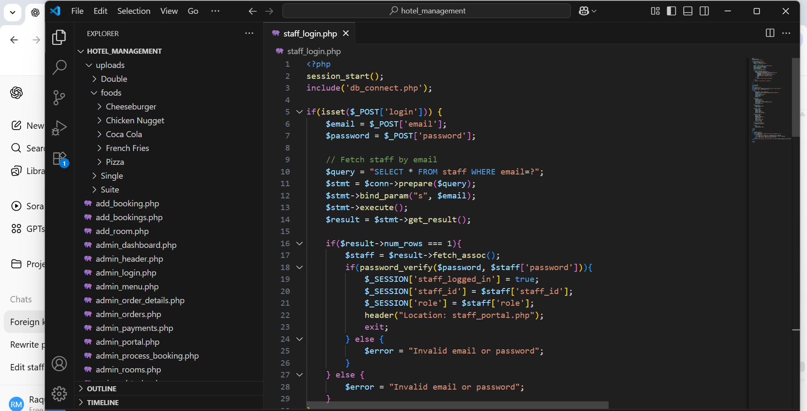
Screenshot of the hotel management folder

Slide 10
Database Configuration
The next step was to set up the database to store all system data.
Created the database named hotel management in phpMyAdmin.
Created the necessary tables:
staff – stores staff information (email, password, role, hire date, etc.)
bookings – stores booking details (customer info, room, dates, status)
payments – stores payment information related to bookings
assigned tasks – stores daily tasks assigned to staff
Ensured foreign key relationships:
payments.booking_id references bookings.booking_id
assigned_tasks.staff_id references staff.staff_id

Slide 11
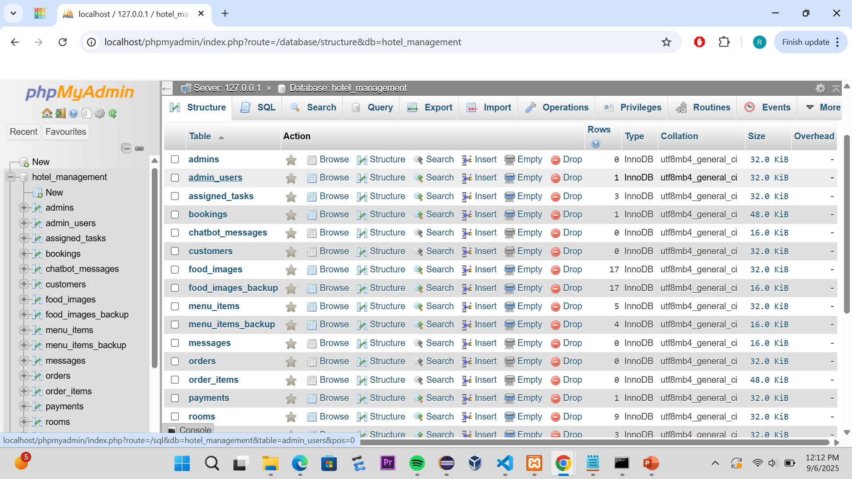
phpMyAdmin showing the tables

Slide 12
ADMIN PORTAL IMPLEMENTATION
The interface started with the Admin Portal because it manages most of the backend functionality.
Admin logs in using admin_login.php.
The Admin Dashboard contains interactive tiles for:
Manage Bookings – view and update customer bookings
Manage Rooms – add, edit, or remove hotel rooms
Manage Menus – update food items and prices
Manage Staff – add new staff members
Payments-Track and process customer payments
Reports-View financial and booking reports

Slide 13
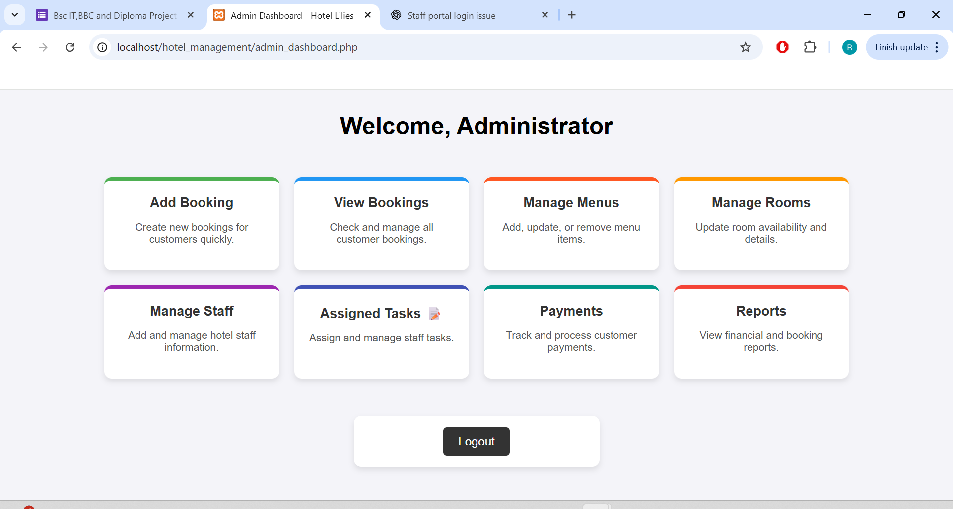
Admin Dashboard

Slide 14
Admin Dashboard
The Admin Dashboard is used by administrators to manage staff, bookings, payments, menus, orders, and task assignments. It acts as the control center of the system.
🔹 Sections in Admin Dashboard
Admin Dashboard
Central landing page after login.
Provides navigation links to all admin features.
Manage Staff
Add, edit, or delete staff members.
Assign roles (e.g., Receptionist, Cleaner, Chef, Manager, Admin).
Manage Rooms / Bookings
Allows admins to view, add, or update room bookings.
Bookings include customer name, dates, and payment status.
Payments Management
View and verify customer payments.
Helps track financial records linked to bookings.

Slide 15
Sections in admin dashboard
Menu Management
Add new food/menu items with images, price, and name.
Update or remove existing menu items.
Remove items no longer needed.
Support multiple images per item for better display
Assigned Tasks
Assign new tasks to staff (with description and deadline).
View all tasks and update task statuses.

Slide 16
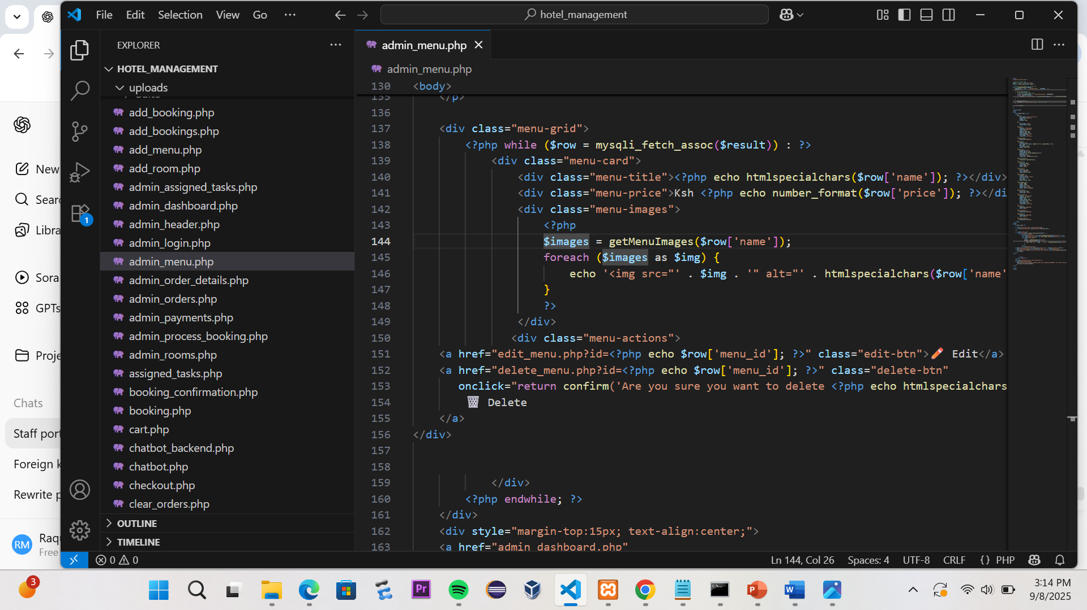
Admin_menu.php

Slide 17
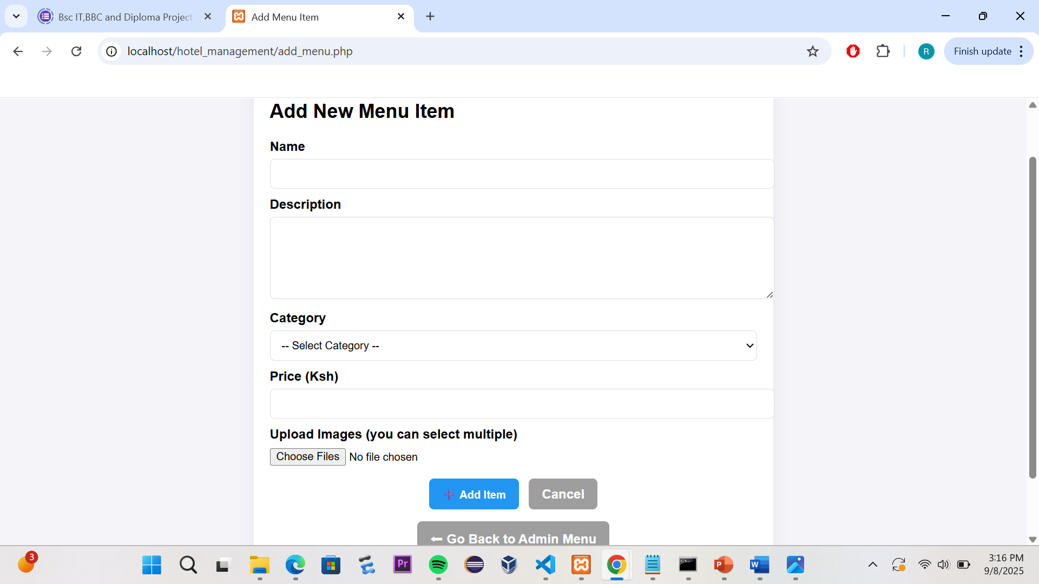
Add_menu.php

Slide 18
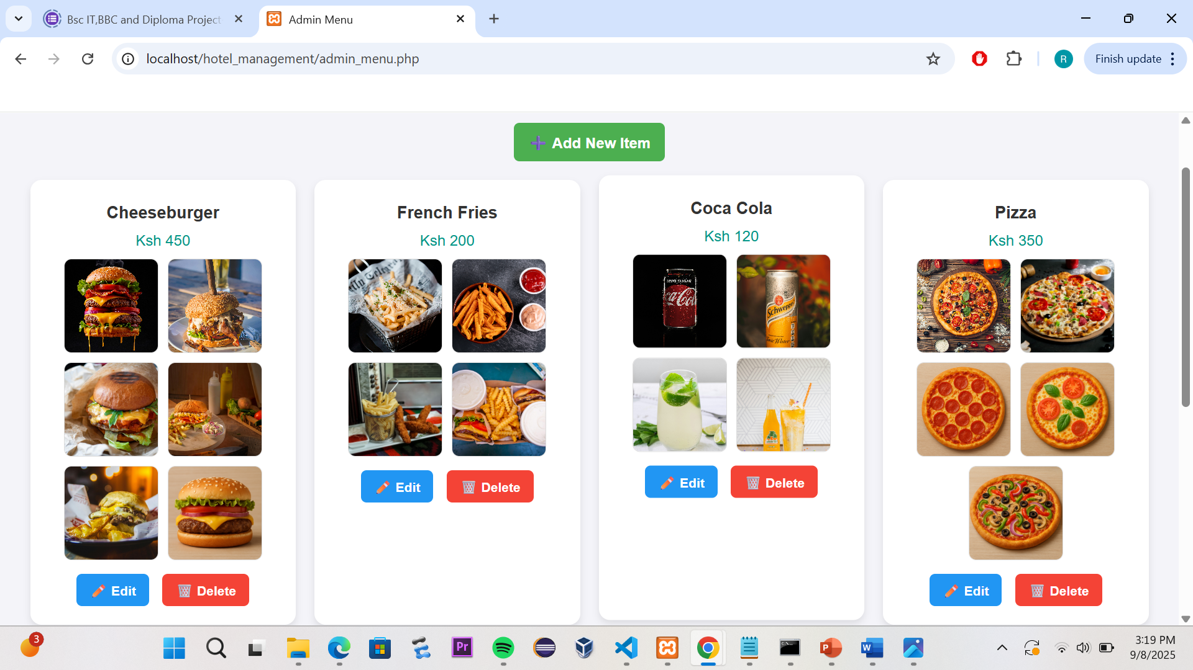
Management of the Menu Orders

Slide 19
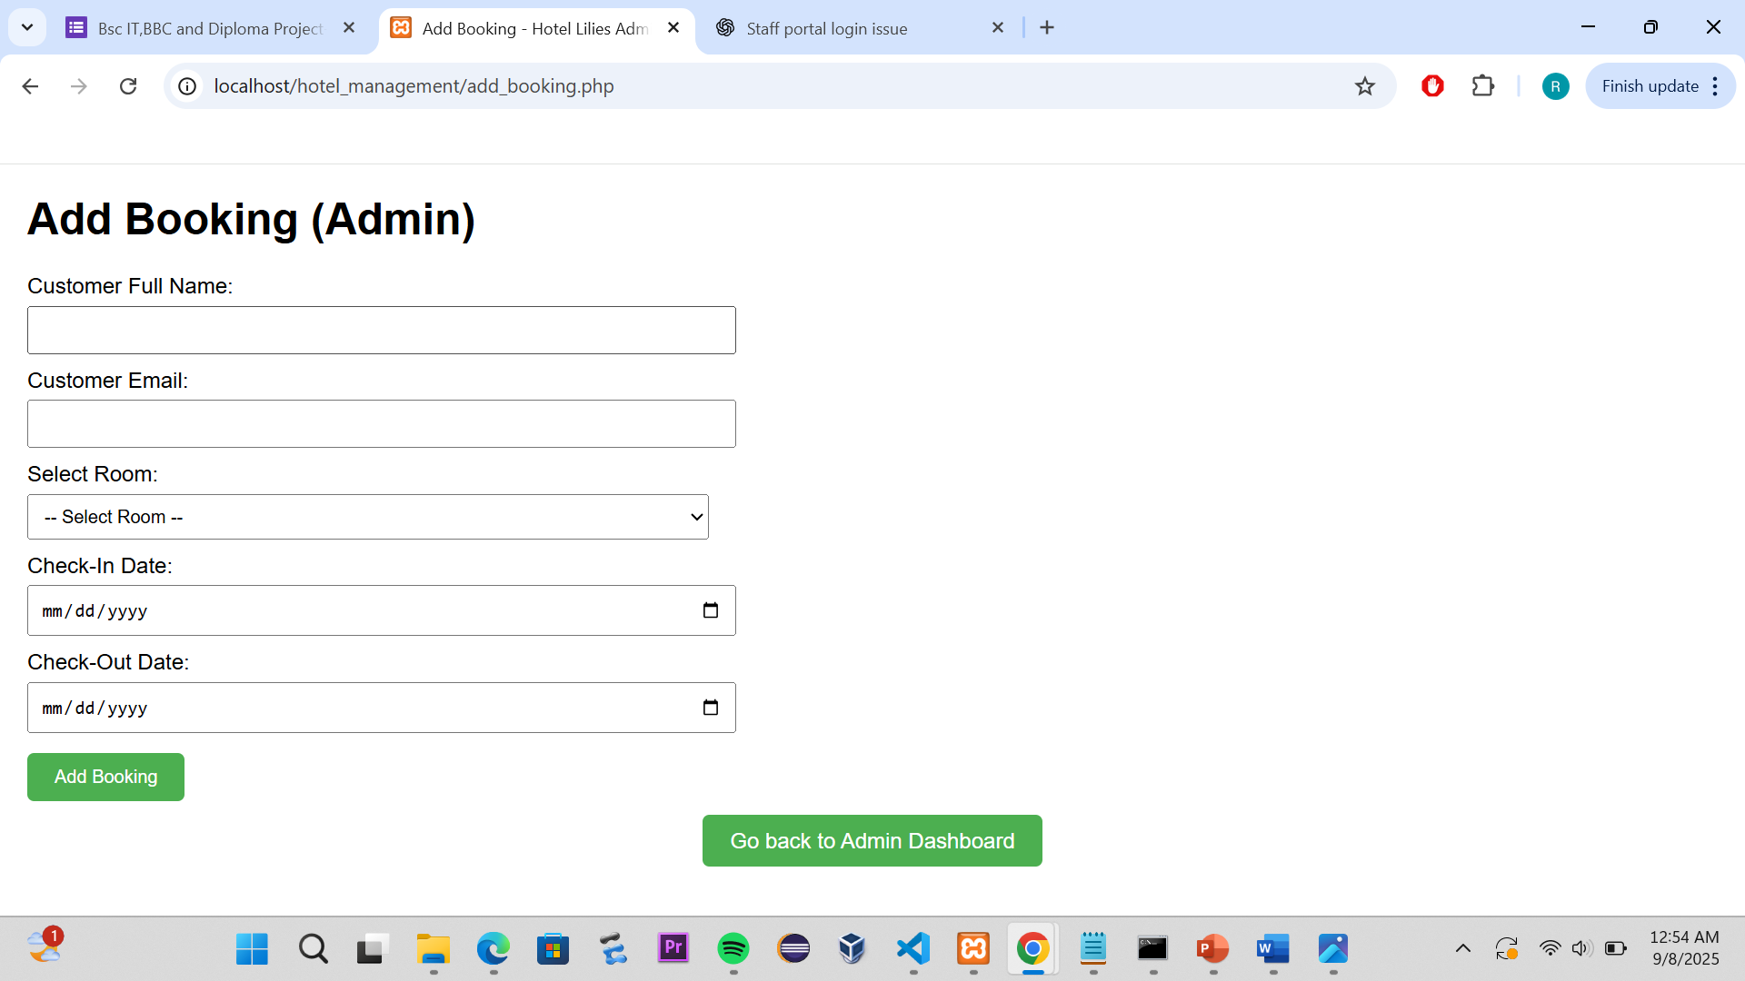
Table of bookings with action buttons.

Slide 20
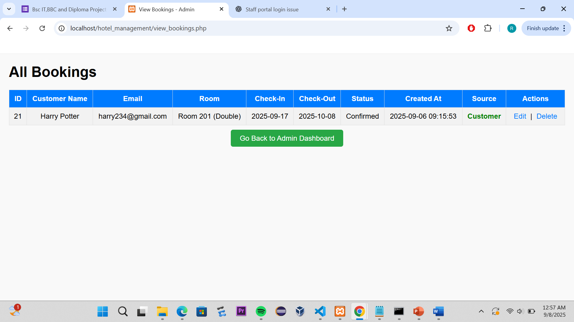
Table of bookings with action buttons.

Slide 21
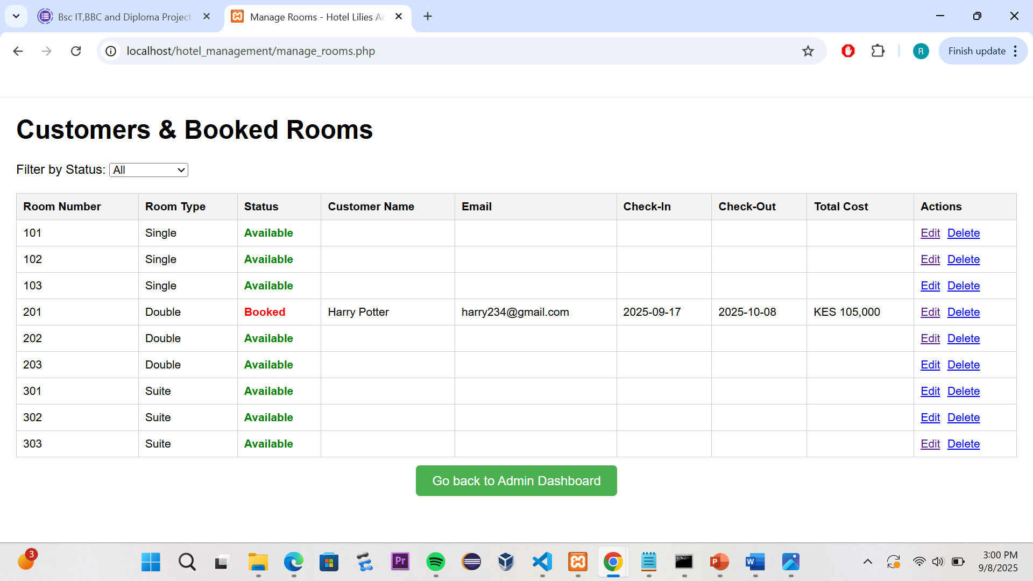
Management of Rooms

Slide 22
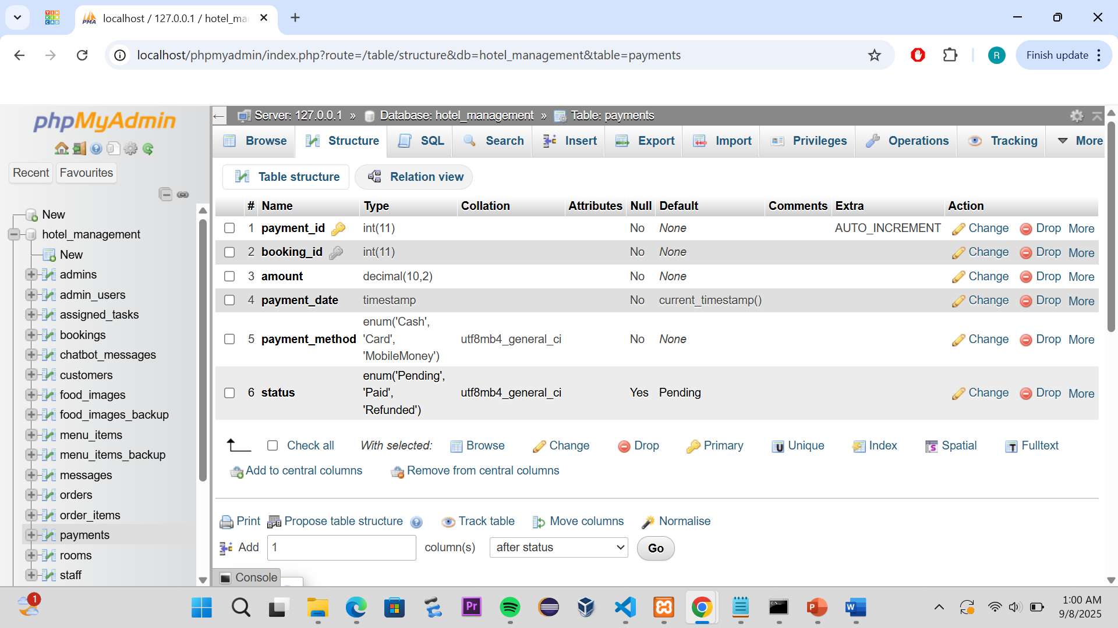
Payments Management

Slide 23
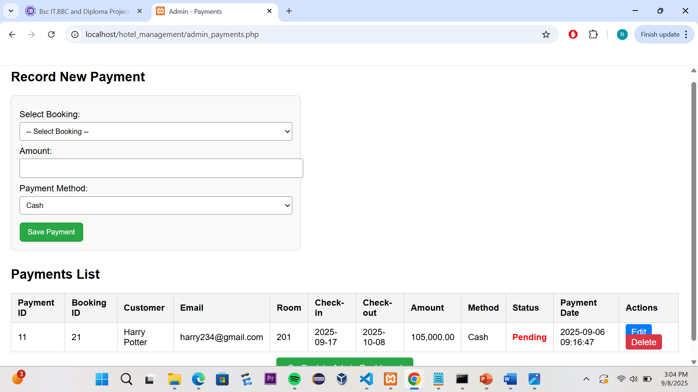
Payment Management

Slide 24
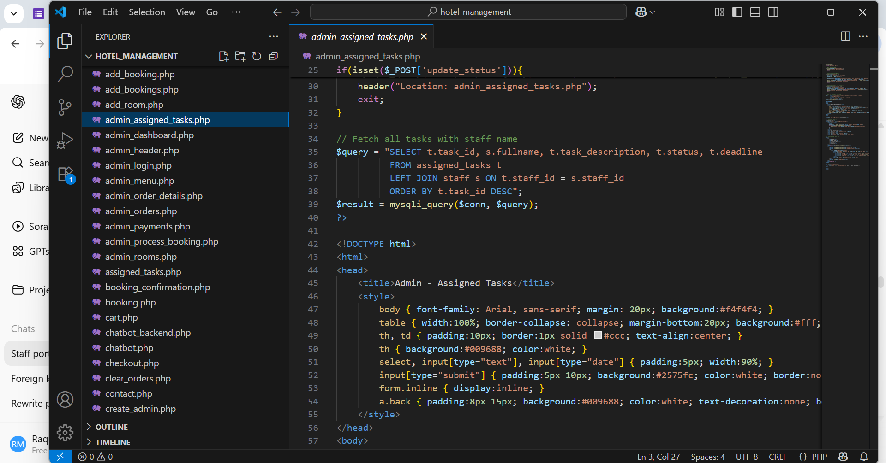
admin_assigned_tasks.php

Slide 25
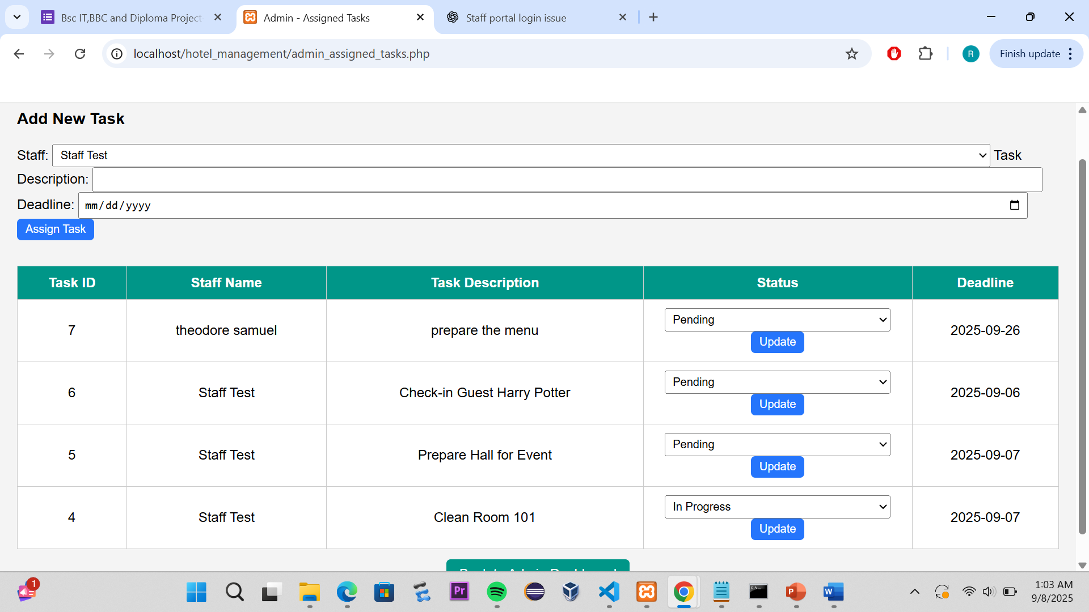
Assigned Tasks

Slide 26
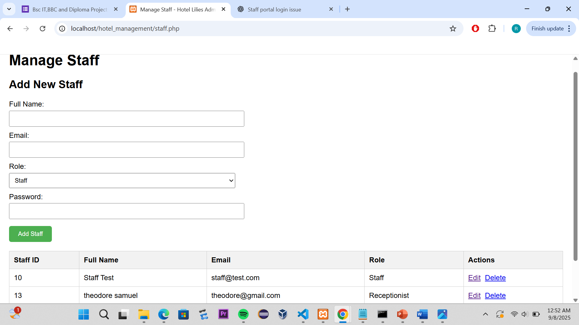
Staff list with edit/delete buttons.

Slide 27
Reports
Provides summaries and analytics for management.
Key reports include:
Bookings Report – list of all customer bookings with dates and statuses.
Payments Report – summary of received payments, outstanding balances.
Menu/Orders Report – which menu items are most popular, revenue generated.
Helps Admins make data-driven decisions and monitor business performance.

Slide 28
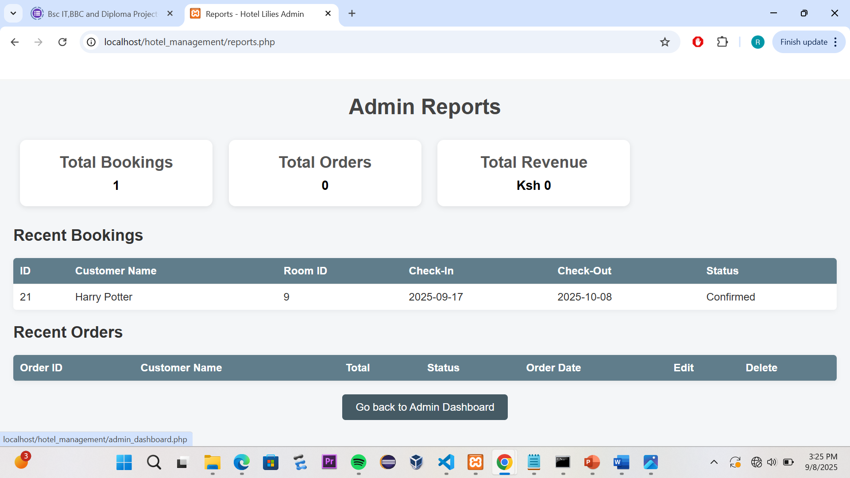
Screenshot of the Reports

Slide 29
STAFF PORTAL IMPLEMENTATION
Admin can add staff members who will later log in to the staff portal.
Staff accounts are stored in the staff table with unique emails and hashed passwords.
After the admin adds staff, they can login to the staff portal.
Staff login via staff login.php
Credentials: Unique per staff(e.gstaff1@example.com)
Password:default-staff123(hashed in the database for security)
Security measures implemented::
Only staff can access the portal(session verification)
Admin credentials cannot login into the staff portal.

Slide 30
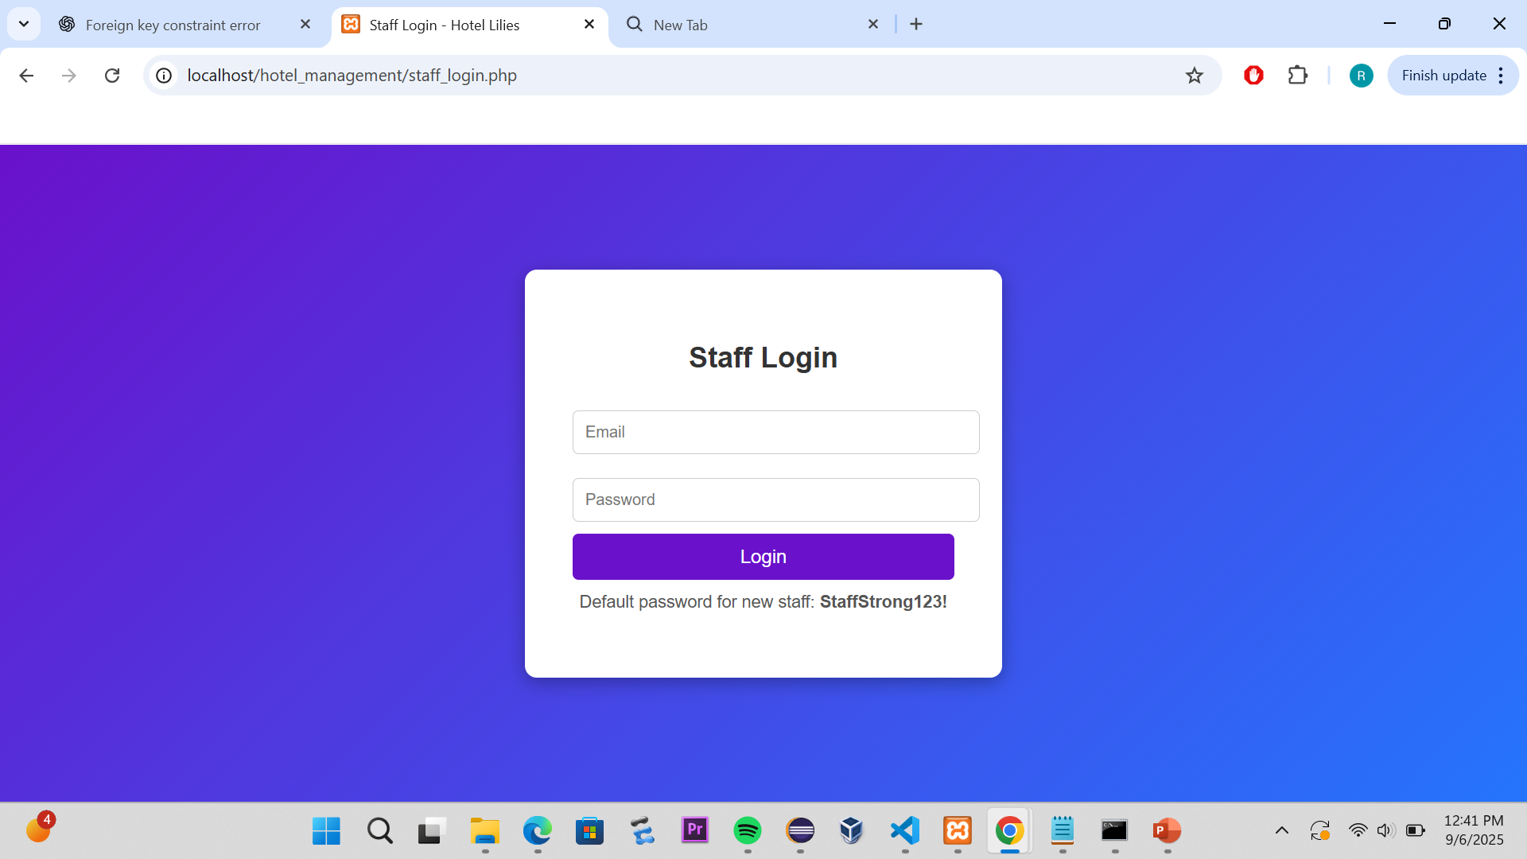
Staff Login Page

Slide 31
Staff Portal Dashboard
Once logged in, the staff sees a dashboard with actionable tiles.
Tiles include:
Update Bookings – allows staff to view all bookings and update their status
Assigned Tasks – displays tasks assigned specifically to the logged-in staff
Additional buttons below the tiles:
Go Back to Homepage – returns to the main website index
Logout – safely ends the staff session

Slide 32
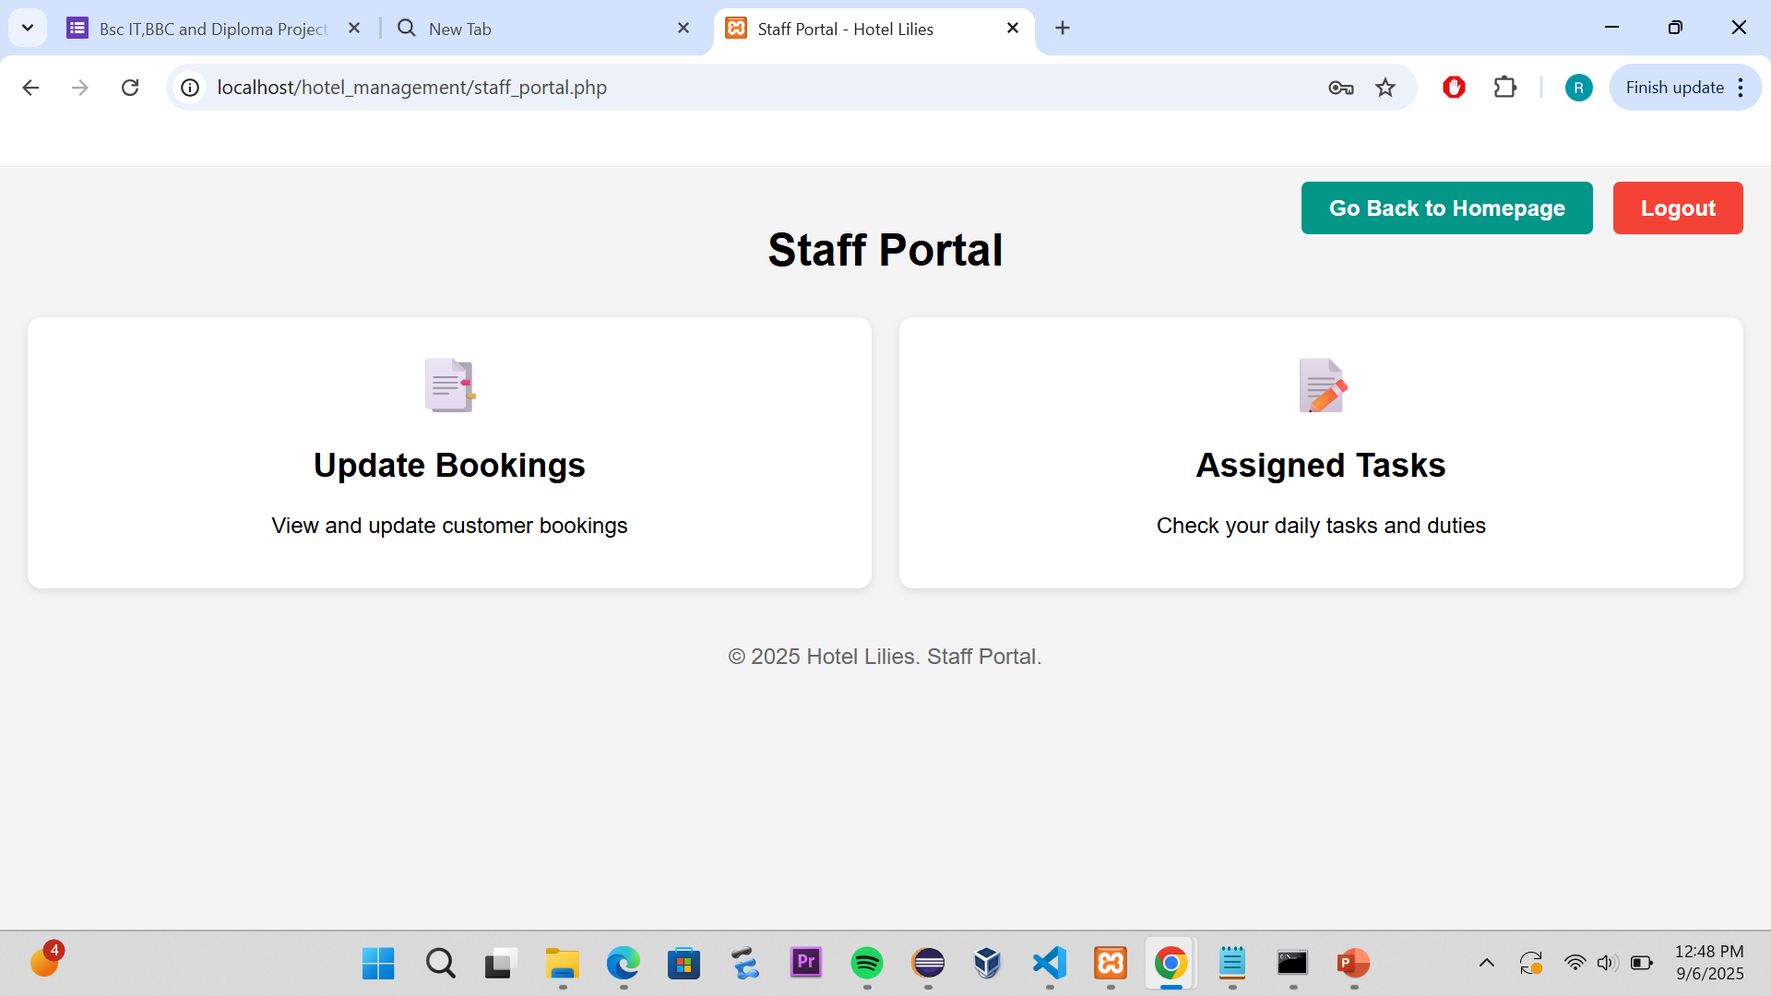
Screenshot of the staff portal dashboard

Slide 33
Viewing & Updating Bookings
Staff can manage bookings from staff_bookings.php.
Clicking Update Bookings opens a table of all bookings:
Booking ID
Customer Name
Booking Status (Pending, Confirmed, Checked-in, Checked-out, Cancelled)
Payment Status (Pending, Paid, Refunded)
Action → Update button
Clicking Update opens update_booking.php, where staff can:
Change Booking Status via a dropdown
Change Payment Status via a dropdown
Submit changes to update the database

Slide 34
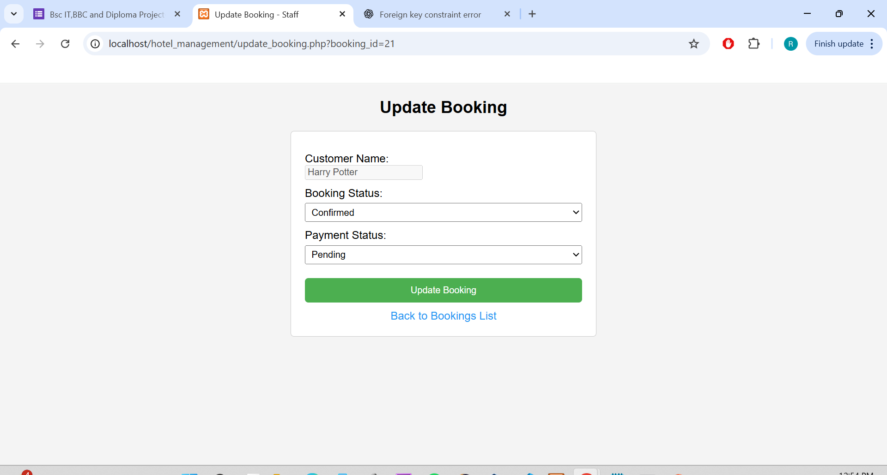
Update Booking form.

Slide 35
Assigned Tasks
Staff can view and manage their daily tasks via assigned_tasks.php.
The table shows:
Task ID
Task Description
Status (Pending, In Progress, Completed)
Deadline
Action → Update Status inline
Tasks are assigned to staff via staff_id and only visible to the respective staff member.

Slide 36
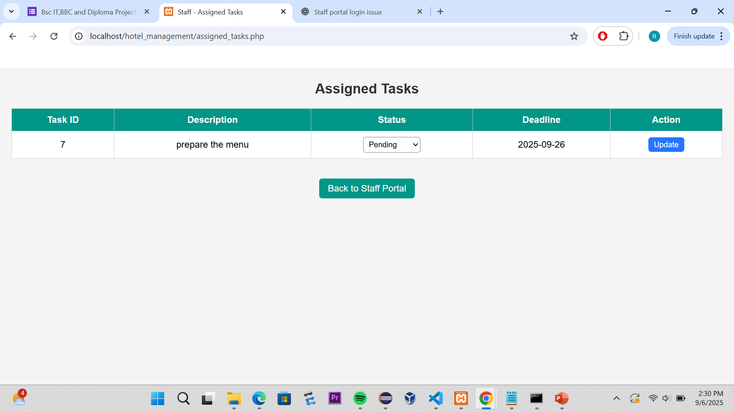
Assigned Tasks Screenshot

Slide 37
CUSTOMER PORTAL IMPLEMENTATION
The Customer Portal allows guests to interact with the hotel system without needing an account. It provides easy access to rooms, menu, payments, and support tools.
1. View Available Rooms
Displays a slideshow of rooms available for booking.
Customers can check details such as room type, price, and availability.
From this section, customers can proceed to make a booking.

Slide 38
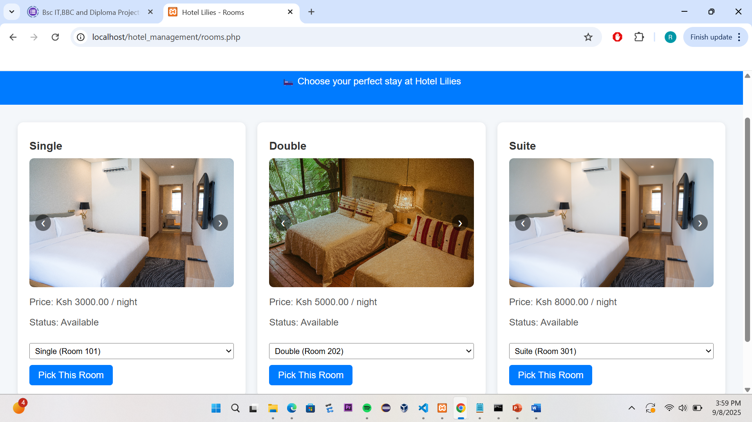
Rooms.php

Slide 39
Menu &Payments
View Restaurant Menu
Shows a list of food and drinks offered by the hotel.
Displays item names, prices, and images.
Helps customers browse the menu before visiting or ordering.
View Payments
Allows customers to view and make payments for their bookings.
Uses the session email ($_SESSION['customer email']) to display their payment history.
Provides a secure way to pay online for bookings.

Slide 40
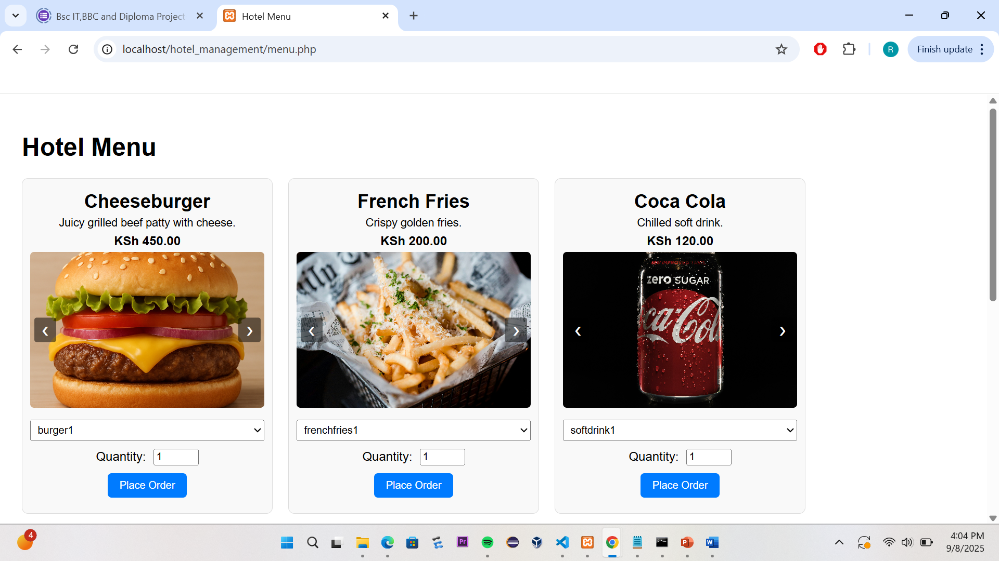
Menu.php

Slide 41
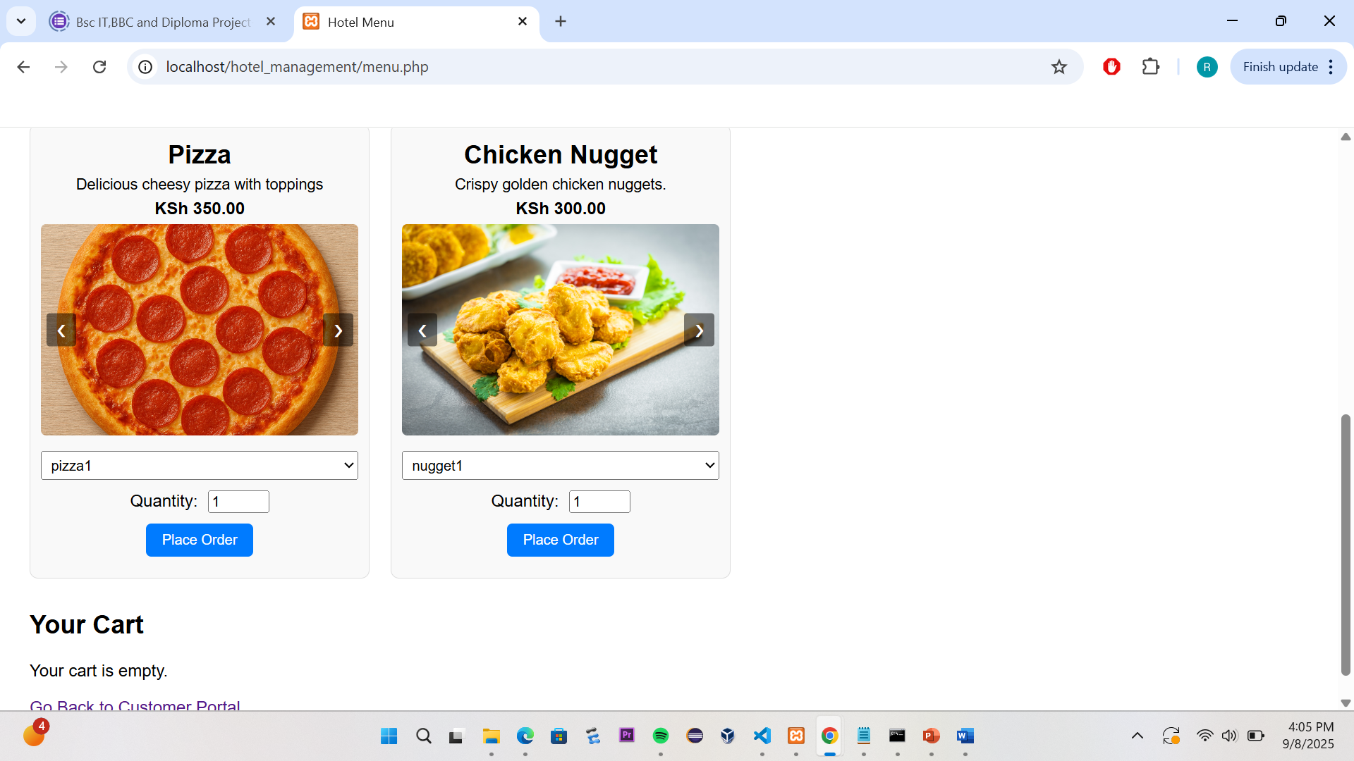
Menu.php

Slide 42
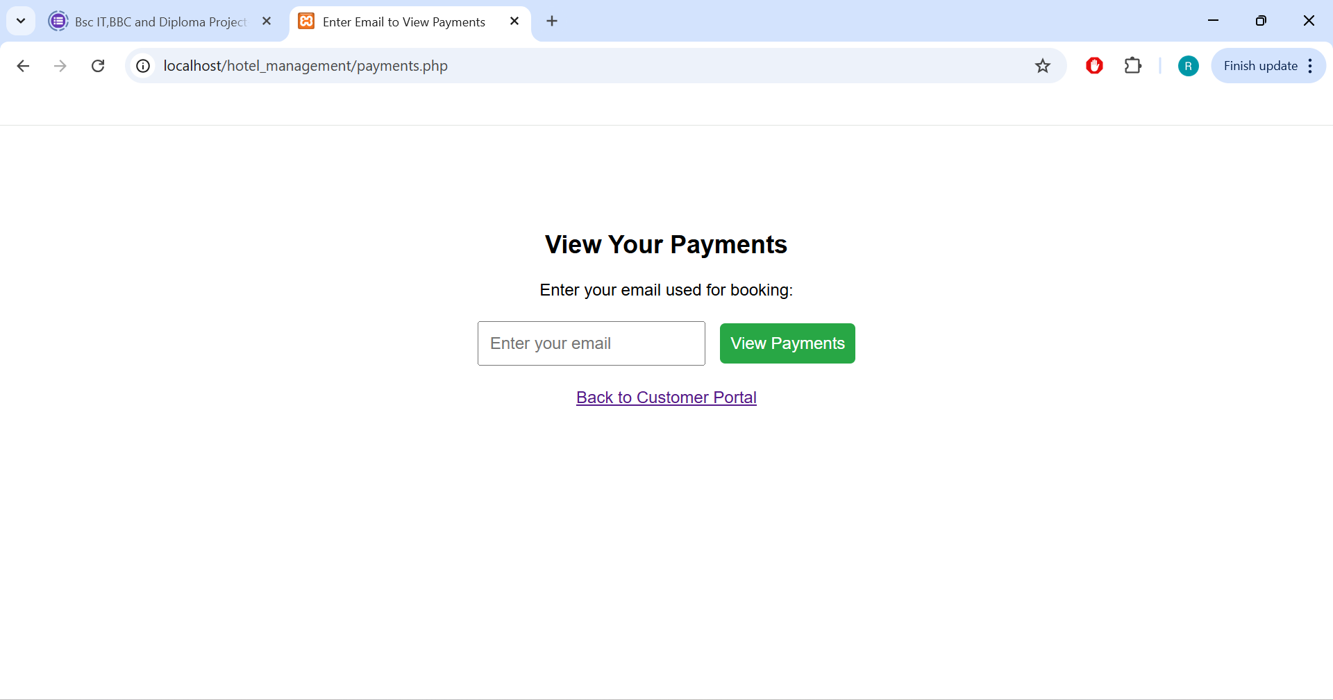
Payments

Slide 43
Hotel Assistant (Chatbot)
The Hotel Assistant is a rule-based chatbot designed to provide automated responses to common customer queries. It is implemented in hotel_assistant.php as a lightweight chat interface that mimics real-time messaging between the hotel and the customer.
Type of Chatbot
This chatbot is primarily rule-based / FAQ-driven.
Instead of advanced AI, it relies on predefined responses mapped to keywords or phrases.
For example, if a customer asks “How much is a single room?”, the chatbot looks for keywords like “room” or “price” and provides the corresponding answer.

Slide 44
Chatbot Frontend and Backend
Frontend (Chat Interface)
Built using HTML, CSS, and JavaScript for a conversational UI.
Messages appear in a scrolling chat window with alternating styles
(customer vs. bot).
Input is handled via a text field where the customer types their query.
Backend (PHP Logic)
The chatbot script (hotel_assistant.php) uses PHP to process input.
Customer queries are compared against a list of common questions stored
in an array or database table.
If a match is found, the chatbot returns a predefined answer.

Slide 45
Navigation
Functions Provided
Answers frequently asked questions (FAQs) about:
Room availability
Booking process
Payment methods
Hotel facilities and services
Provides quick navigation links (example “Click here to view available rooms”).
Works 24/7 without staff intervention, reducing workload on hotel reception.

Slide 46
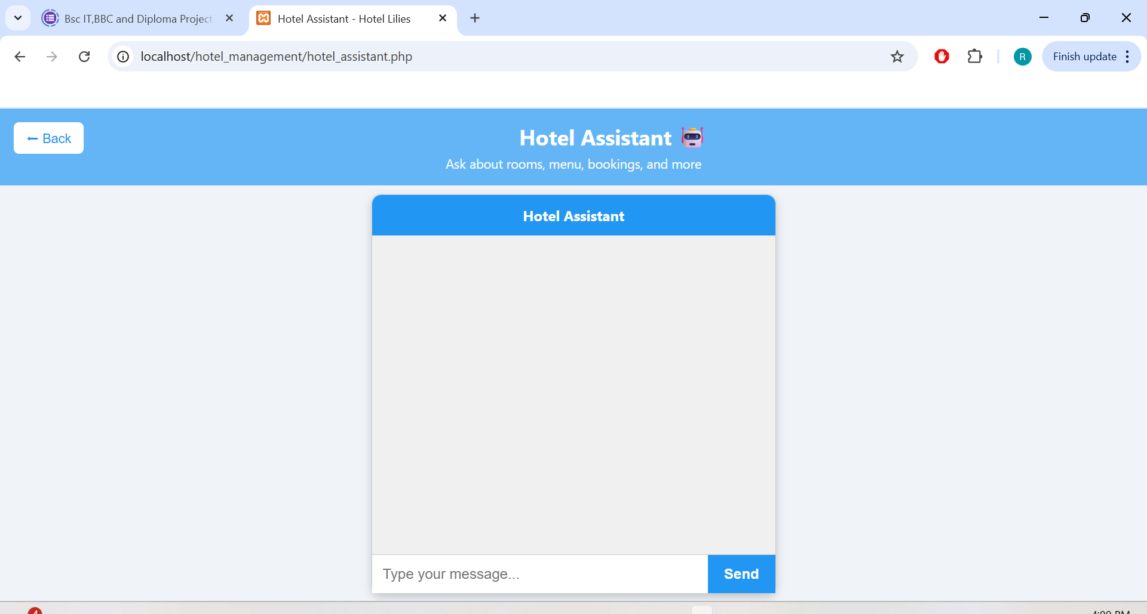
Hotel Assistant

Slide 47
Chatbot Explanation
Customer types a query in the chat input box.
Query is sent to the PHP backend via form submission or AJAX.
PHP searches for keywords in the query.
Example: “Do you have Wi-Fi?” → matches keyword “Wi-Fi”.
A predefined response is retrieved.
Example response: “Yes, all our rooms have free Wi-Fi.”
Response is displayed back in the chat window in real time.
It is useful because of the following reasons:
Provides instant answers to common queries
Reduces the number of repetitive calls/messages to hotel staff.
Enhances customer satisfaction by giving quick guidance
Can be expanded in the future into a more intelligent AI chatbot.

Slide 48
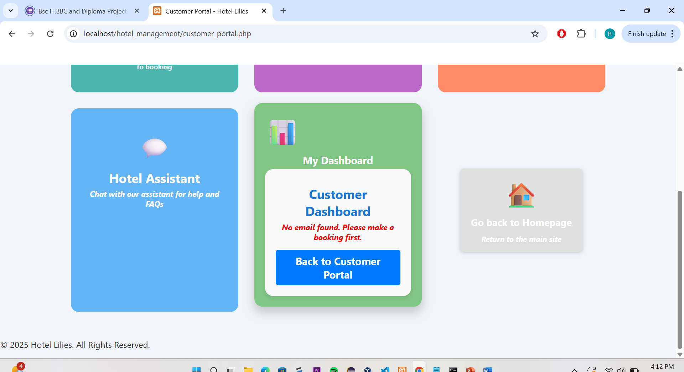
Customer Portal

Slide 49
Customer Dashboard
My Dashboard
Personalized customer dashboard embedded into the portal.
Displays customer’s active bookings, payments, and other quick details.
Keeps all important information in one place.
Go Back to Homepage
Provides a quick way to return to the main site (index.php).
Simple navigation feature for customers.

Slide 50
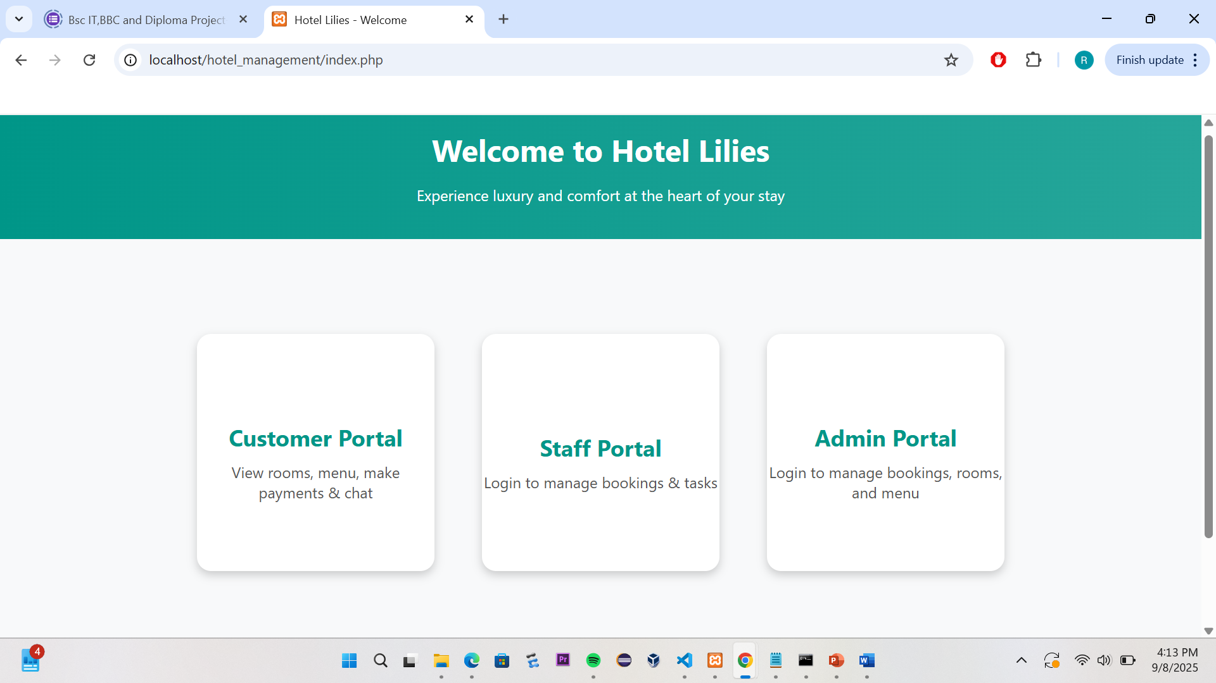
The Hotel Homepage

Slide 51
Conclusion
The Hotel Management System for Hotel Lilies was successfully designed and implemented to streamline operations across the admin, staff, and customer portals. The system provides a centralized platform where administrators can manage staff, rooms, bookings, payments, and restaurant menus with ease. Staff members are empowered with role-specific tools to fulfill their responsibilities efficiently, while customers benefit from a user-friendly portal that enables them to explore available rooms, view restaurant menus, make payments, and interact with the Hotel Assistant chatbot.
The integration of modules such as menu management, payments tracking, and the Hotel Assistant chatbot demonstrates how technology can improve both operational efficiency and customer satisfaction. By reducing reliance on manual processes, the system minimizes errors, ensures data consistency, and enhances communication between the hotel and its clients. Overall, the system has met its objectives of providing a reliable, scalable, and user-centered hotel management solution.

Slide 52
Contributions
Racheal’s contribution
Designed the architecture of the system, including the Admin Portal and Customer Portal.
Fully implemented the Admin Portal, covering:
Staff management (adding, editing, deleting staff and assigning roles).
Room and booking management (adding rooms, managing bookings, and monitoring status).
Payments management (viewing, verifying, and tracking payments).
Menu management (adding, editing, and deleting food items with multi-image upload support).
Reports module (to support decision-making).

Slide 53
Contributions
Fully developed and implemented the Customer Portal, including modules for room browsing, restaurant menu viewing, payments, and the Hotel Assistant chatbot.
Designed the database that contains the customer portal and Admin Portal tables necessary for the system.
Setup database structures and handled image and file management.
Conducted testing, debugging, and documentation of the system to ensure smooth performance.

Slide 54
Contributions
Stephen’s Contributions
Fully designed and coded the Staff Portal to enable task assignment and tracking.
Contributed to refining the user interface by providing feedback and minor adjustments in styling.
Designed the database that contains the staff portal tables necessary for the system.
testing and debugging different modules of the system.
verifying database queries and ensuring that CRUD operations functioned correctly.
Participated in preparing parts of the system documentation.

